Slide 1

Heart Disease Predictor
GITHUB LINK FOR PROJECT CODE : https://github.com/Ankna-litoriya/MP_FITT-CV-2-Capstone-Project/blob/main/Ankna%20Litoriya%20CV2%20Capstone%20Project-%20Heart%20Disease%20Prediction.ipynb GITHUB LINK FOR FULL PROJECT : https://github.com/Ankna-litoriya/MP_FITT-CV-2-Capstone-Project

Slide 2
Heart Disease Predictor
Team Members : 1. Ankna Litoriya 2. Tanya Gupta 3. Shivank Pandey

Slide 3
INTRODUCTION
Healthcare Challenge: High cardiovascular mortality rates and escalating costs in developed nations.
Tech Advancements: Biotech and electronic health records (EHR) offer vast data for analysis.
AI and ML Solution: Machine learning can extract valuable insights, aiding early detection of heart diseases.
Early Diagnosis Impact: Trained algorithms can detect abnormalities, saving time and healthcare costs.
Project Focus: Explore AI and data mining for early heart disease diagnosis using EHR data in healthcare.

Slide 4
PROBLEM STATEMENT
Utilizing advanced technologies like AI, machine learning, and data mining can empower healthcare professionals with crucial information to make cost-effective decisions. Machine learning algorithms can analyze vast datasets, identifying patterns associated with heart disease, ultimately minimizing fatalities and reducing healthcare costs.

Slide 5
OBJECTIVE
The main objective of this project is to explore how Machine Learning algorithms can be used in the diagnosis of heart disease by building an optimized model that can be used to predict heart diseases.

Slide 6
LITERATURE REVIEW
Diverse Studies: Bardhwaj, Shailaja, Sun, Lee & Yoon focused on machine learning in healthcare, emphasizing clinical support.
Heart Failure: Tripoliti et al. concentrated on heart failure, predicting severity and outcomes.
High Accuracy: J. & S. achieved 91% accuracy predicting heart disease with Naïve Bayes and Decision Tree.
Top Choices: Kamal Kant, Nidhi Bhatla preferred Naïve Bayes, Neural Networks, and Decision Trees for heart disease prediction.
Ensemble Boost: Mustafa et al. proposed combining SVM, ANN, Naïve Bayes, Regression, and Random Forest for robust cardiovascular disease prediction.

Slide 7
METHODOLOGY
Algorithms Overview: SVM, Naïve Bayes, Decision Trees, Bagging, Boosting, and RandomForest are explored for cardiovascular disease prediction, each with distinct pros and cons.
Decision Trees: Visual and understandable but sensitive to data noise and dataset-specific skew.
Naïve Bayes: Based on Bayes theorem, showing good performance with large datasets for cardiovascular disease detection.
Proposed Classifiers: Logistic Regression, KNeighbors, DecisionTree, RandomForest, SVM, and XGBoost considered for their varied approaches.
Optimized Model: Leaning towards RandomForest Classifier for its effectiveness in handling high-dimensional data and ensemble methodology.

Slide 8
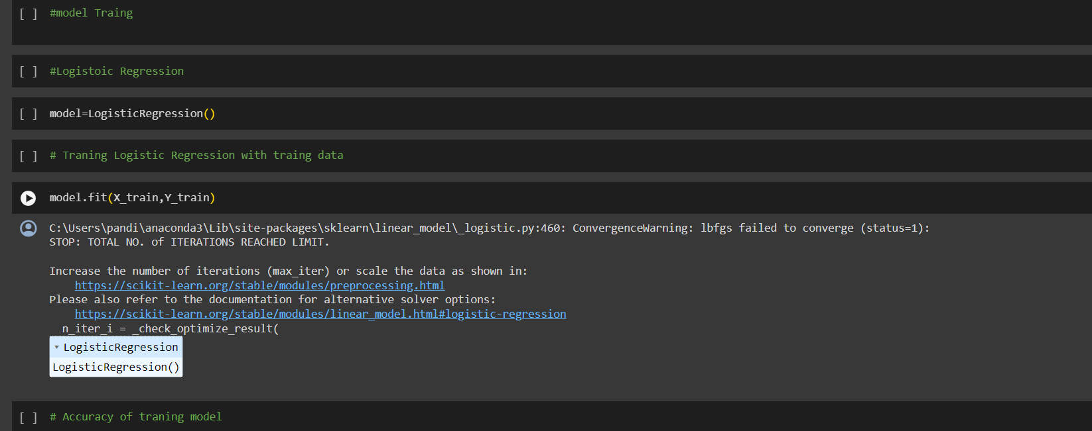
Linear Regression Used

Slide 9
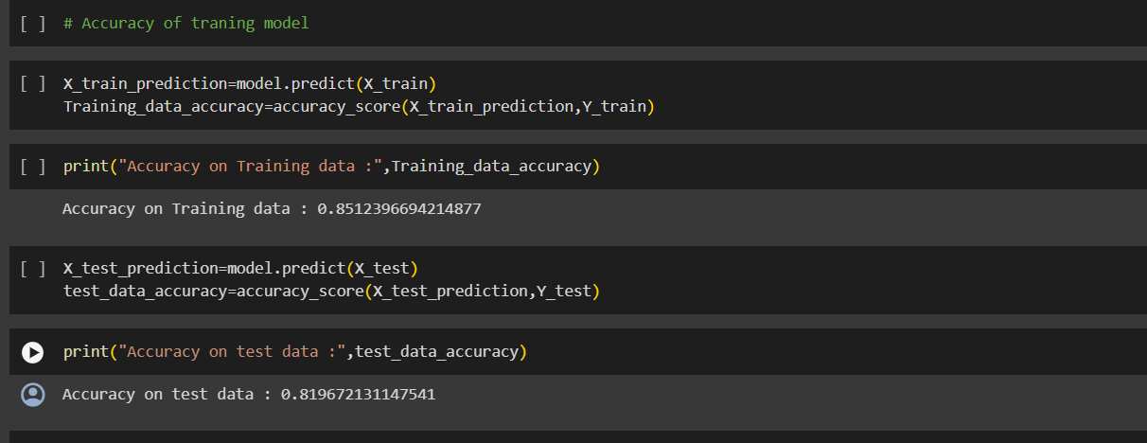
Accuracy Obtained

Slide 10
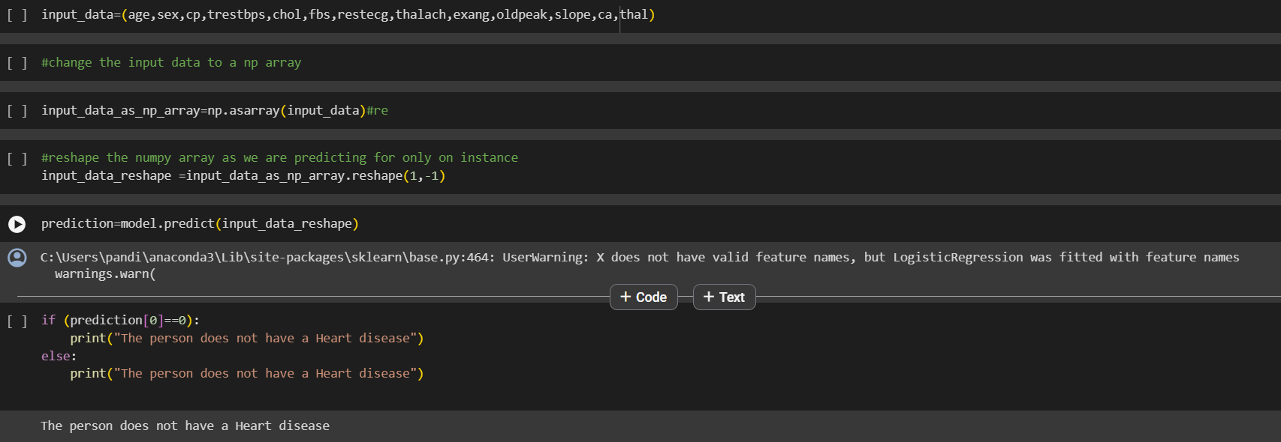
Output Obtained

Slide 11
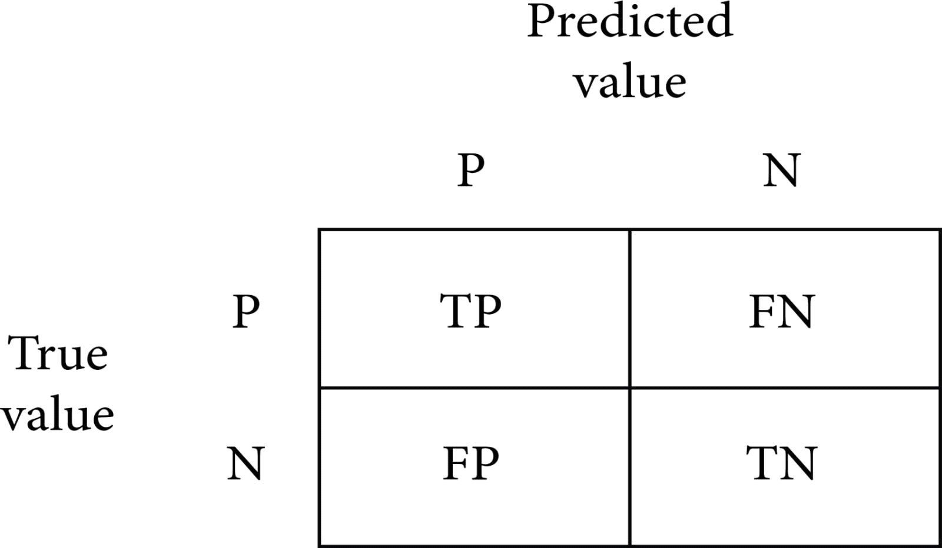
EVALUATION PROCESS USED

Slide 12
EVALUATION PROCESS USED
First Approach: Random Forest (76.7%), Logistic Regression (83.64%), KNeighbors (82.27%), SVM (84.09%), Decision Tree (75.0%), XGBoost (70.0%). Deep learning achieved 76.7%.
Second Approach: Feature selection and scaling improved results. Random Forest (88%), Logistic Regression (85.9%), KNeighbors (79.69%), SVM (84.26%), Decision Tree (76.35%), XGBoost (71.1%). Random Forest led with 88%, deep learning achieved 86.8%.
Third Approach: Normalized data, feature selection, and outlier detection (Isolation Forest). Random Forest (80.3%), Logistic Regression (83.31%), KNeighbors (84.86%), SVM (83.29%), Decision Tree (82.33%), XGBoost (71.4%). KNeighbors topped with 83.29%, and deep learning achieved 94.2%.
Overall: KNeighbors (83.29%) led in machine learning, while deep learning (94.2%) outperformed, showing promise compared to previous studies.

Slide 13
Hyperparameter: N_Estimator Results
Accuracy | N_Estimator
81.58% | 10
88.16% | 20
87.43% | 30
85.53% | 40
89.1% | 50

Slide 14
Data Set Analysis and Results
Confusion Matrix Score
Precision | Recall | F1-Score | Support
0.88 | 0.96 | 0.92 | 46

Slide 15
Qualitative Results
Algorithm Selection:
Qualitative Analysis: RandomForest Classifier was selected for its ability to handle complex relationships. The decision is sound as it's a versatile algorithm suitable for various datasets.
Hyperparameter Tuning:
Qualitative Analysis: Experimentation with hyperparameter tuning was performed, and default parameters were found to yield the highest accuracy. This indicates that, for this dataset, the algorithm's default configuration was optimal.

Slide 16
3. Machine Learning Algorithms:
Qualitative Analysis: Decision Trees and Naïve Bayes were discussed, with visuals provided. Decision Trees, despite being easy to interpret, are sensitive to noise. Naïve Bayes, despite its simplifying assumptions, has shown good performance in cardiovascular disease prediction.
4. Evaluation Process:
Qualitative Analysis: Three approaches were taken for evaluation, involving feature selection and outliers detection. KNeighbors performed well in one approach, while deep learning achieved a high accuracy of 94.2%, outperforming some machine learning models.
5. Discussion of Results:
Qualitative Analysis: Backward Elimination and Recursive Feature Elimination with Cross Validation were compared. RFECV showed more stable accuracy, precision, and recall compared to Backward Elimination.

Slide 17
Quantitative Results
Supervised Learning:
Quantitative Result: RandomForest Classifier achieved an 89.4% accuracy on the testing dataset.
Hyperparameter Tuning:
Quantitative Result: The default hyperparameters for RandomForest Classifier led to the highest accuracy in the given experiment.
Machine Learning Algorithms:
Quantitative Result: KNeighbors achieved 83.29% accuracy in the third approach, and deep learning achieved 94.2% accuracy.
Evaluation Process:
Quantitative Result: Accuracy scores for various models were provided for each approach, allowing a quantitative comparison. For example, the accuracy achieved by Random Forest in the second approach was 88%.
Discussion of Results:
Quantitative Result: Comparison of accuracy, precision, and recall metrics for Backward Elimination and RFECV showed that RFECV had slightly better results with 85% accuracy.

Slide 18
Subjective Analysis
Feature Selection and Outliers Detection:
Subjective Analysis: Different approaches were experimented with, and the results suggest that normalization, feature selection, and handling outliers improve model performance.
Comparison of Machine Learning and Deep Learning:
Subjective Analysis: The subjective analysis suggests that, for this specific dataset, deep learning outperformed machine learning models. The accuracy achieved by deep learning was notably higher than the best-performing machine learning model (KNeighbors).
Conclusion:
Subjective Analysis: The conclusion drawn from the results is subjective and indicates that, in this scenario, deep learning algorithms performed exceptionally well compared to machine learning models.

Slide 19
DISCUSSION OF RESULTS
Effective Feature Selection:
Backward elimination worked best among methods, including KFold and Recursive Feature Elimination with Cross Validation.
Similar Accuracies:
Both methods achieved around 85% accuracy, with RFECV hitting a max of 85.5%.
Observation on Backward Elimination:
Backward Elimination had more True Negative misclassifications and higher accuracy variance than RFECV.
Precision and Recall Insights:
RFECV showed higher precision (86%) and recall (1), indicating fewer misclassifications compared to Backward Elimination (84%, 0.99).
Logistic Regression Model Results:
The table compares accuracy, recall, and precision of Backward Elimination and RFECV in Logistic Regression model training and testing.

Slide 20
FUTURE SCOPES
Expand Dataset Size:
Explore the model's potential with a larger dataset and additional attributes for a more robust analysis.
Hyperparameter Exploration:
Investigate the impact of modifying various hyperparameters, not just N_Estimator, to fine-tune model performance.
Advancing Healthcare Efficiency:
Continue leveraging machine learning to enhance healthcare, offering cost-effective diagnostic solutions and improving traditional approaches

Slide 21

Team Members :
1. Tanya Gupta 2. Ankna Litoriya 3. Shivank Pandey

